Slide 1
Stock prediction
Group 6
University of San Diego
23rd June, 2025
Anusha Bandaru | Rakesh Bhatija | Vidhaan Appaji

Slide 2
Problem statement
Stock prices behave differently everyday – some are volatile, others stable or trending or somewhere in between.
Identifying such patterns manually is time-consuming and inconsistent.
Traditional models struggle to categorize this without pre-defined rules.
Our goal: automate the discovery of behavior patterns to help investors make smarter decisions.

Slide 3

Why This Matters to Business
No two trading days are alike – spotting patterns early can drive profitable decisions.
Many investors and analysts lack information to help predict the volatility of stock.
We saw an opportunity to make market insights accessible and actionable.

Slide 4
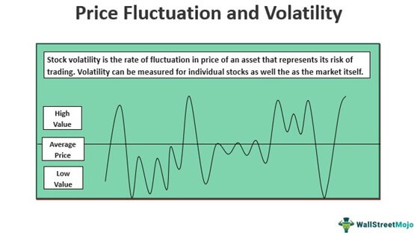
Approach
Created a 2-Phase AI Pipeline
Discover patterns using unsupervised learning (clustering days by behavior)
Classify real-time stock volatility using machine learning to predict those patterns

Slide 5
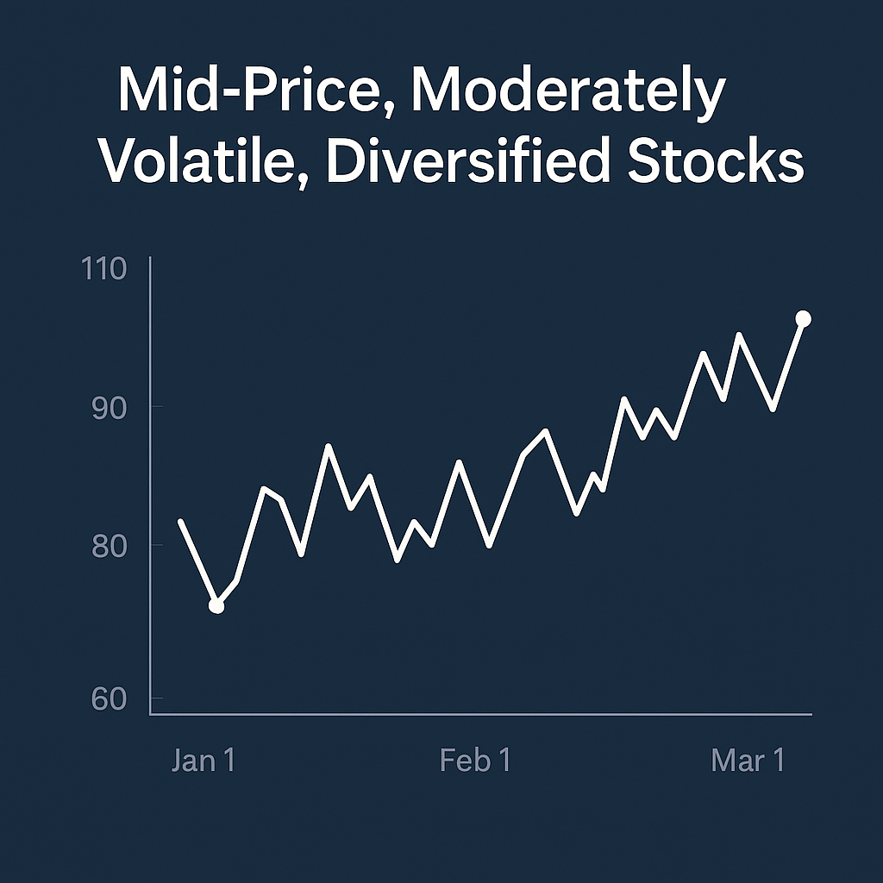
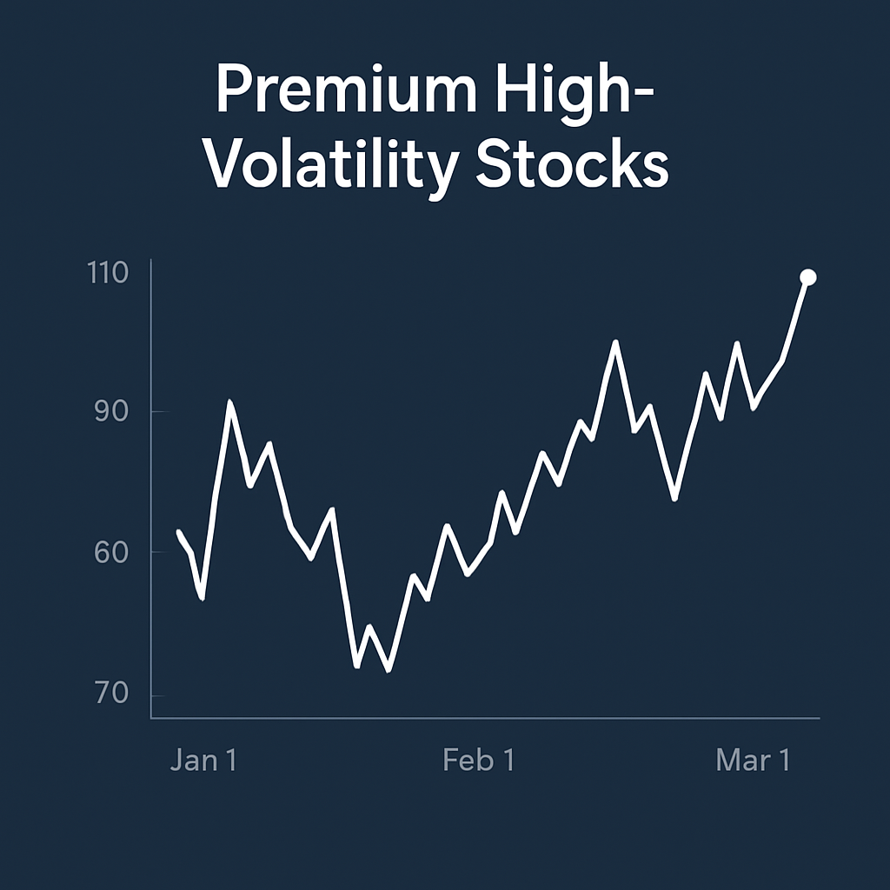
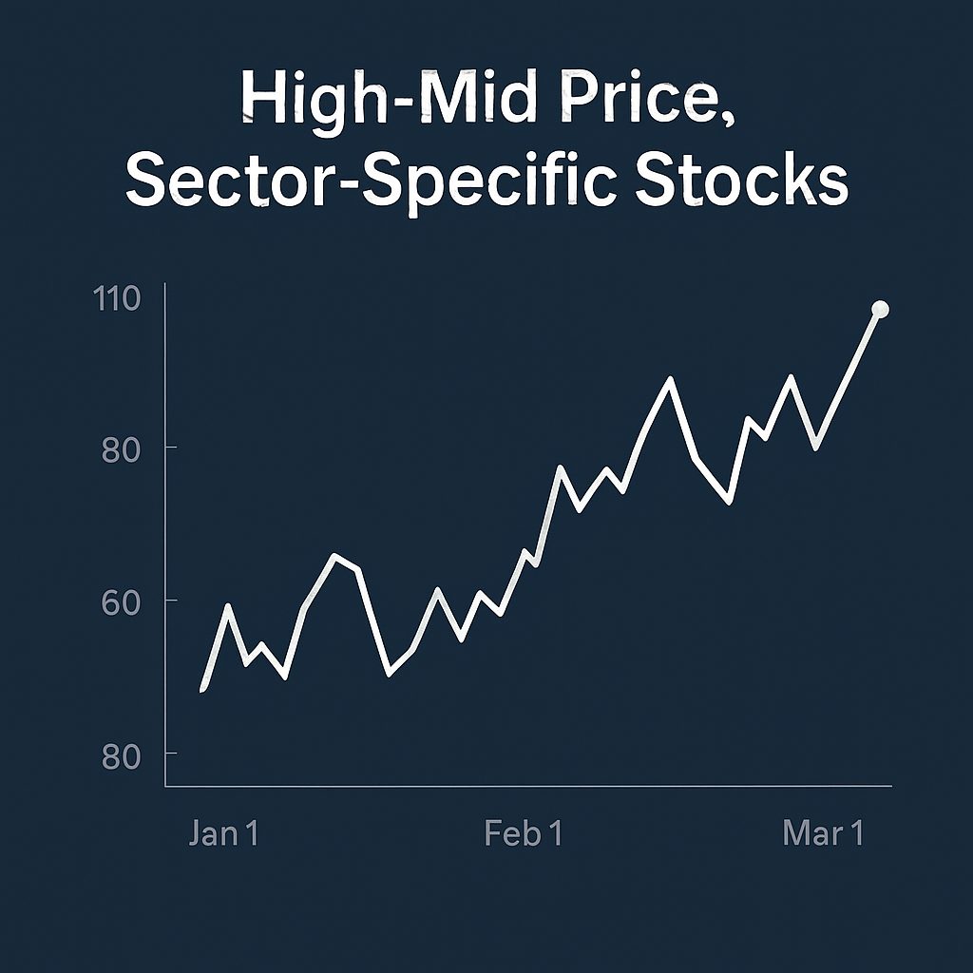
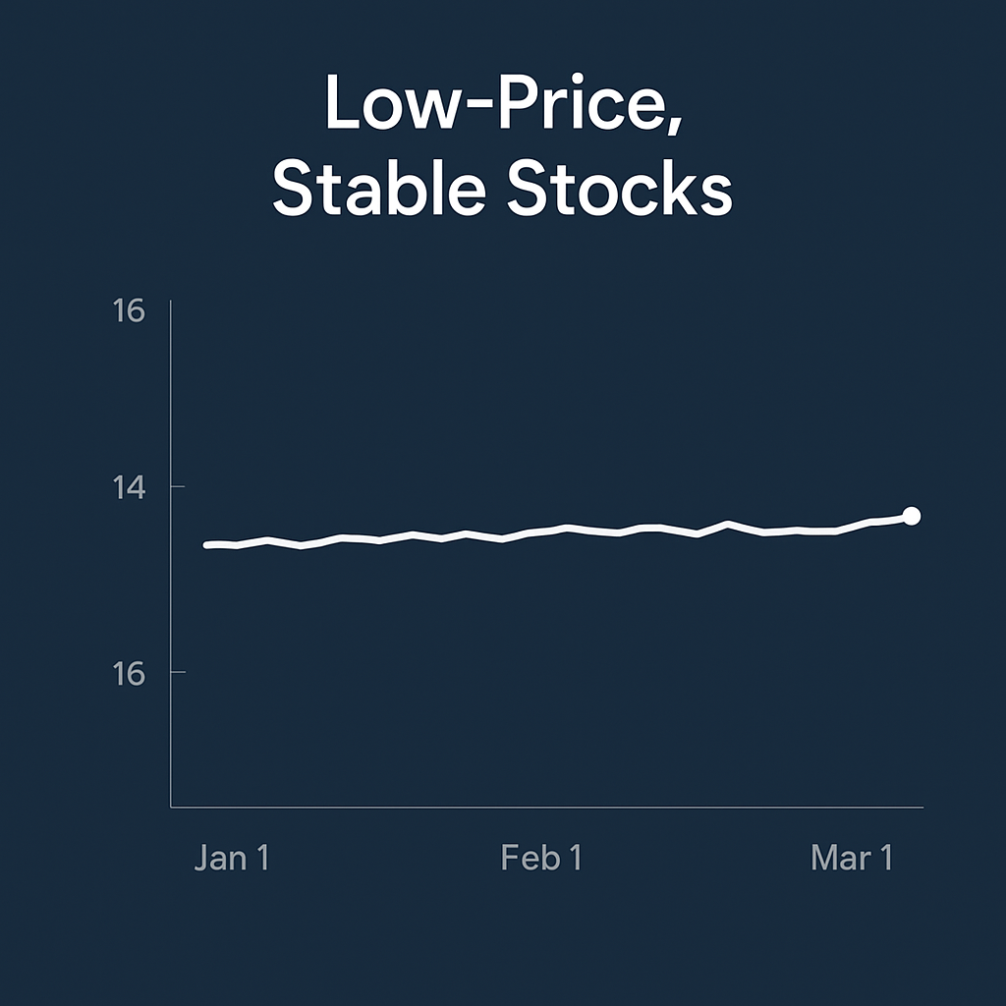
Market segmentation
We identified 4 distinct stock day types and segmented the market into 4 behavioral groups:
Mid-price, moderately volatile, diversified stocks
Premium high-volatility stocks
High-mid price sector-specific stocks
Low-price, stable stocks

Slide 6
Training ml models
We trained 3 machine learning models to predict stock day type:
Random Forest Classifier – An ensemble model combining multiple decision trees for improved accuracy and robustness
Histogram-Based Gradient Boosting (HGB) – A fast and powerful boosting technique optimized for numeric tabular data
Support Vector Machine (SVM) – A model that finds the optimal margin between different classes in the feature space

Slide 7
Evaluation metrics
Model | Accuracy (%) | Precision | Recall | Key Insights
Random Forest | 99.60 | G0: 1.00, G1: 0.97, G2: 1.00, G3: 1.00 | G0: 1.00, G1: 0.99, G2: 0.99, G3: 1.00 | Excellent overall; few confusions between G0 and G2
HGB | 99.88 | G0: 1.00, G1: 0.99, G2: 1.00, G3: 1.00 | G0: 1.00, G1: 0.98, G2: 1.00, G3: 1.00 | Best-performing model across all categories
SVM | 99.73 | G0: 1.00, G1: 0.99, G2: 1.00, G3: 1.00 | G0: 1.00, G1: 0.98, G2: 0.99, G3: 1.00 | Slightly more overlap between groups 1 and 2
G0 to G3 refer to market segmentation behavioral groups.
G0 = Mid-price, moderately volatile, diversified stocks | G1 = Premium high-volatility stocks |
G2 = High-mid price sector-specific stocks | G3 = Low-price, stable stocks
Histogram based Gradient Boosting was the top performer with 99.88% accuracy overall.

Slide 8
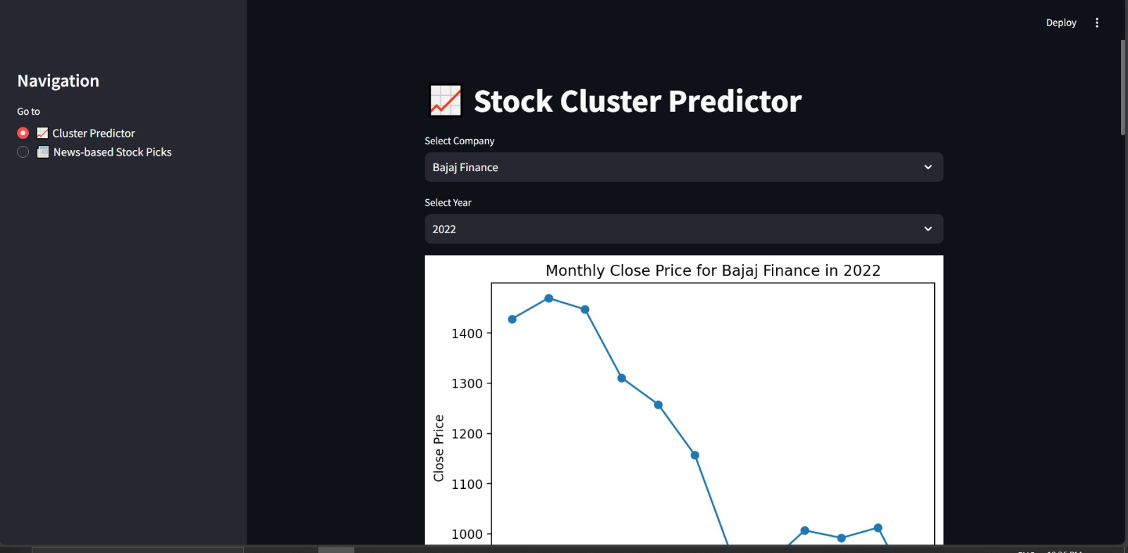
Business Impact: Real-Time Dashboard
We built an interactive app, a visual, click-and-use tool for investors that:
Lets users input stock and date
Classifies the stock’s behavior using our AI model and outputs the market behavior grouped.
Explains the trend, volatility and the market segment in plain and simple English generated by an LLM (gemini-2.0-flash-lite).
Real-Time Dashboard UI

Slide 9
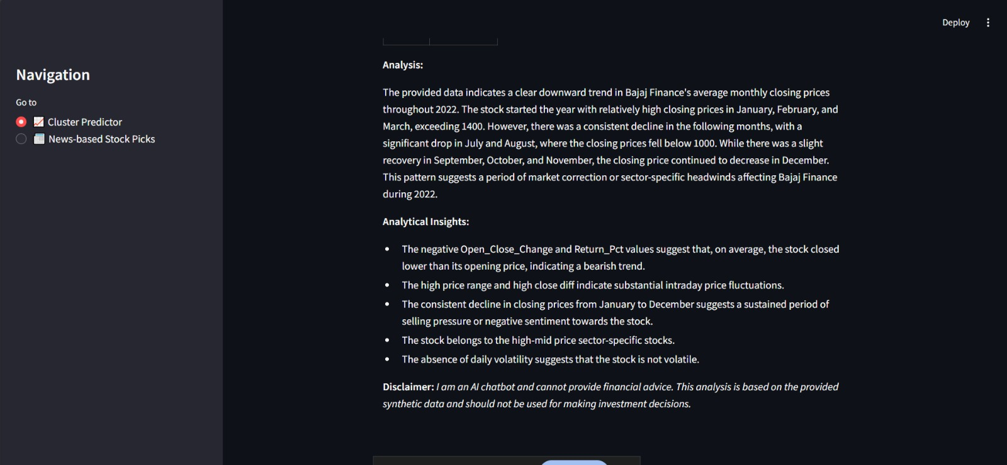
Business Impact – Live Recommendations from News
Our second feature reads live financial news and:
The app scrapes headlines and summaries from the top 5 financial websites using Google News.
It filters relevant articles using keywords and financial sentiment analysis.
An LLM processes the filtered information and generates a list of the best stocks to invest in today, along with reasons.
LLM generated Summary reference

Slide 10
Risk & Ethics Considerations
Risks
Potential misclassification during unusual or extreme market events
Mitigations
Introduce human oversight for critical financial actions
Continuously retrain the model with new data to adapt to market changes
Regulatory Considerations
The model does not give financial advice; it offers decision support
Adheres to transparency and accountability expectations in financial AI applications
Ethical Practices
Uses only publicly available data
Designed to support—not replace—human judgment in investing

Slide 11
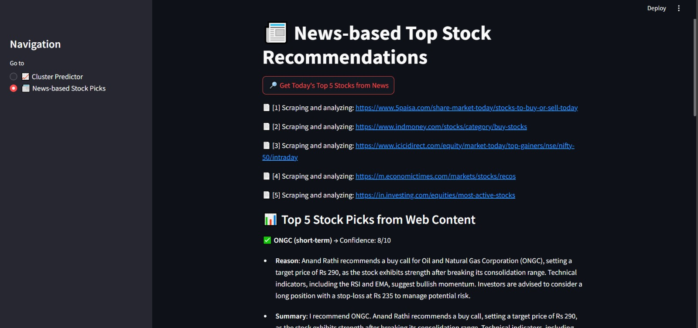
Recommendations
Deploy the model for daily portfolio scanning
Use the news-to-stocks tool to identify timely opportunities
Invest in continued development for LLM and market integration
news-to-stocks

Slide 12
Thank you
Stock Prediction Project Github

